Slide 1
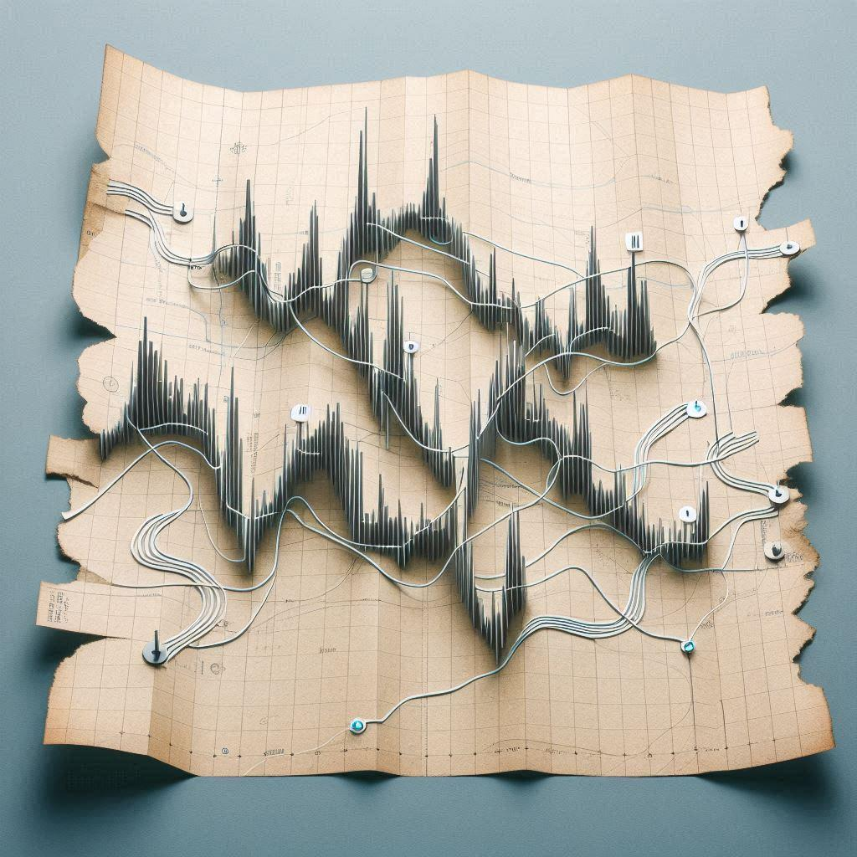
Audio navigation in open-world video games
Jan Borecký
(Microsoft Copilot - paper map with paths as sound waves)

Slide 2
What do I (want to) do
The (ideal) goal:
Create a system that (when imported into an open-world game) procedurally generates music.
The music contains clues to navigate a player in the open world (e.g. to a treasure)
The music is "readable" enough to navigate a visually impaired player in the open world.

Slide 3
Why to do it?
Music plays an important role in computer games from an artistic point of view.
Music could be important even from the functional point of view
Substituting visual information for visually impaired players (and helping the non-impaired in the meantime)
Adding such importance could greatly expand game music creation process

Slide 4
How to do it?
Experiment with non-impaired and visually impaired players on my game
Iteratively play the game and see
Which sounds are (not) useful and how
What is (not) missing to be able to fully navigate only through audio
How well do the players navigate in the open world
Modify the game and repeat
Creates rules for generating music according to the information gathered from playing my experimental game (next slide)

Slide 5
Current state
Deep Sea Rescue
Simple game in Unity to experiment with audio navigation
Player is a submarine at the bottom of the ocean
The task is to find and rescue 6 divers in danger
No light at the ocean floor → Must rely on audio navigation
Collecting player data when playing (position, rotation etc.)
I can replay any playthrough thanks to .json and .csv files containing all the data

Slide 6

Deep Sea Rescue showcase
Disclaimer: The proximity and tilt sounds used in the game are only for early-stage development purposes. That‘s why they sound so horrible.

Slide 7
The future
Get the game to a fully playable state
Create a system for generating music according to what I found out from testing on Deep Sea Rescue
Hopefully implement it into a known open-world game (e.g. No Man’s Sky)
Currently three months in, thesis delivery in winter
Still at the early stages now

Slide 8
Thank you for your attention
Audio navigation in open-world video games
Jan Borecký

